Slide 1

Learning to Generalize for Complex Selection Tasks
Alan Ritter
University of Washington
Sumit Basu
Microsoft Research
IUI 2009
research.microsoft.com/~sumitb/smartselection

Slide 2
Outline
Smart Selection
Learning to Generalize
User Study
Conclusions

Slide 3
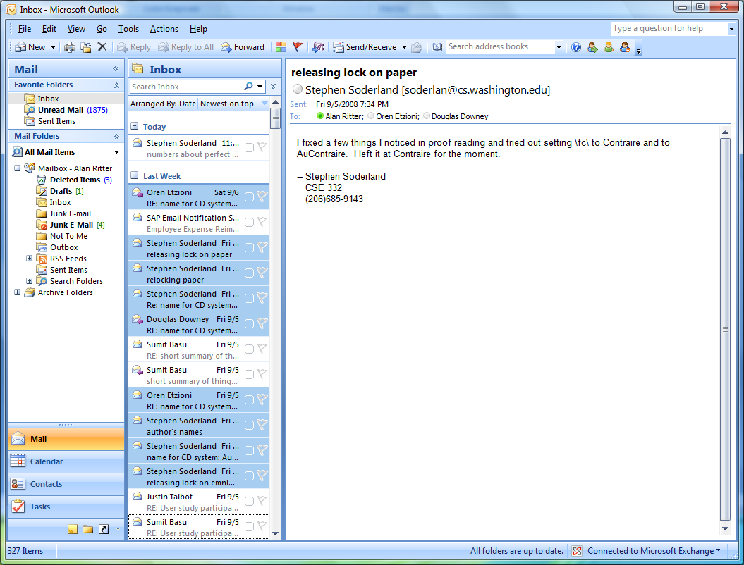
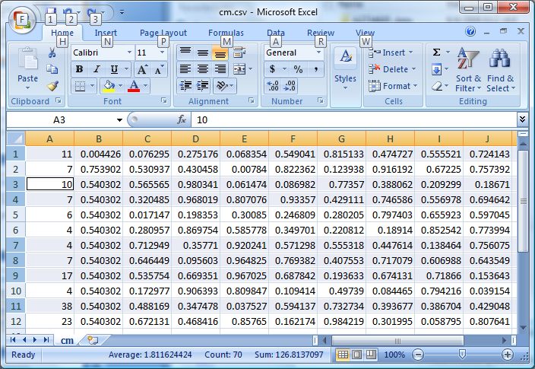
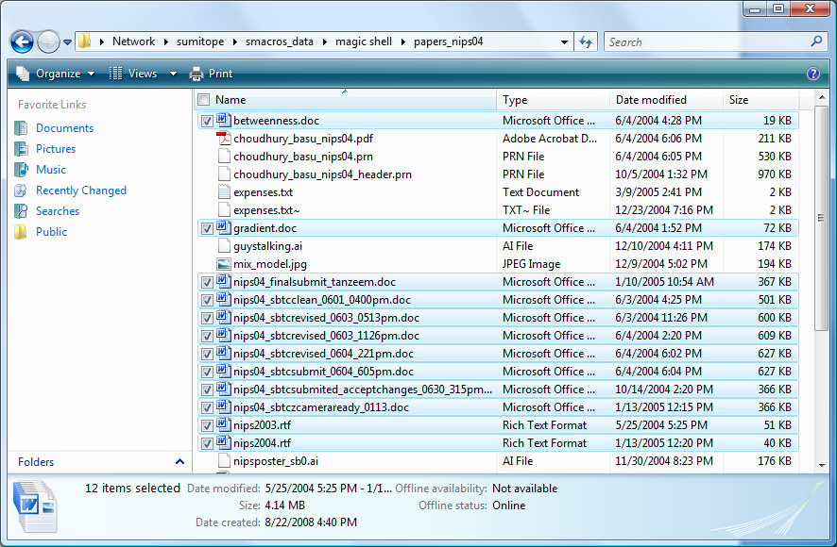
Multiple Selection
Files
HTML list boxes
E-mail
PowerPoint objects
Spreadsheets
Etc…
Complex selection tasks currently require programming knowledge
Unix Shell
Regular Expressions

Slide 4
Our Task: File Selection

Slide 5
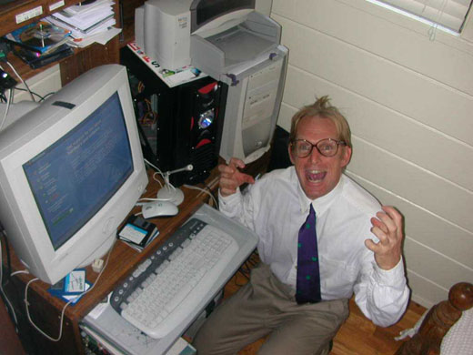


Tedious Selection Tasks
Files do not group together by sorting
Substring of file name (e.g. “copy” or “backup”)
Users forced to click on a large number of files

Slide 6
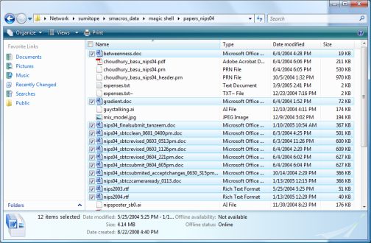

Smart Selection
Classify
Label
Selection Classifier

Slide 7
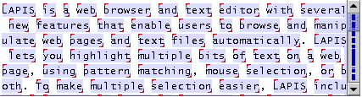
Related Work
Text editing
LAPIS (Miller and Myers IUI 02)
DOM extraction
REFORM (Toomim et. al.CHI 09)
KARMA (Tuchinda et. al. IUI 08)
Other Domains
Image regions: Crayons (Fails and Olsen IUI 03)
Image search: CueFlik (Fogarty et. al. CHI 08)
Notes:
Better to use data to learn
Take further more complex selecctions
-----------------------------------------------
LAPIS (lots of detail): learning mechanism worked well in text editing domain, but has some limitations.
-Can only represent conjunctions of features
-More complex selections are common in filebrowser and other domains
Other related work (less detail) dom extraction – user selects nodes in the dom tree for extraction, other domains, image regions classification and image search

Slide 8

Few Labels Available
one session
Classify
Label
Selection Classifier
Notes:
Very small number of labels
Machine learning -> need lots of labels
---------------------------------------------
Start with an empty set of training data, add until complete
Start from scratch every time
-----------------------------------------------
Main challenge for smart-selection: few labeled examples
User starts with an empty set of training data, and adds to it until task is complete; then throws away. Starts over from scratch in the next task.

Slide 9
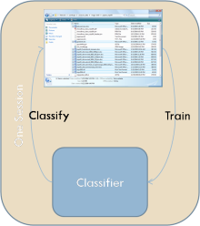
How to use historical tasks?
many users, many sessions
one session
Classify
Label
Selection Classifier

Slide 10
Our Contributions
Make use of many people’s historical data
Learning to Generalize
Flexible selection classifier
Works well for the File Browser Domain

Slide 11
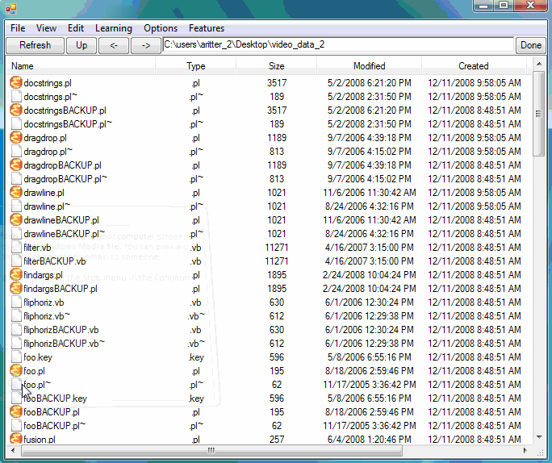
Demo

Slide 12
Outline
Smart Selection
Learning to Generalize
User Study
Conclusions

Slide 13
Basic Classification Framework
Selection Classifier:
Boosted Decision Trees
Limited depth (2)
Adjustable complexity
Features:
File name substrings
File extension
Creation Date
Size
Limited Training Data Available
Classify
Label
Selection Classifier

Slide 14
How can we improve?
bad idea: Heuristics about user’s behavior?
better option: Learn to generalize from Historical Data!

Slide 15
Example Behavioral Feature
Positive Evidence?
Foo.py
Foo.py
Food.txt
Foo2.py
Foo2.py
Learn this from Data!
Bar.py
Bar.py
FBaz.py
FBaz.py
BFoo.doc
FBFoo.py
FBFoo.py
BazFoo.py

Slide 16
How do we Learn from Behavioral Data?
many users, many sessions
one session
Classify
Label
Selection Classifier

Slide 17
Predict Labels for Unlabeled Data
α
many users, many sessions
one session
Behavior Features
Label Regressor
Classify
Label
Selection Classifier
α

Slide 18
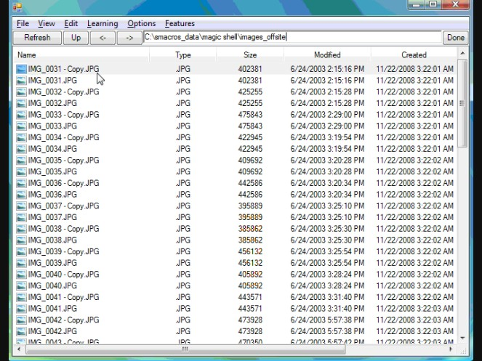
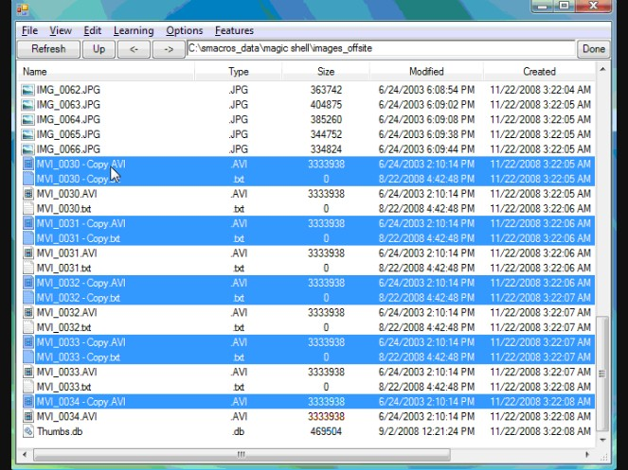
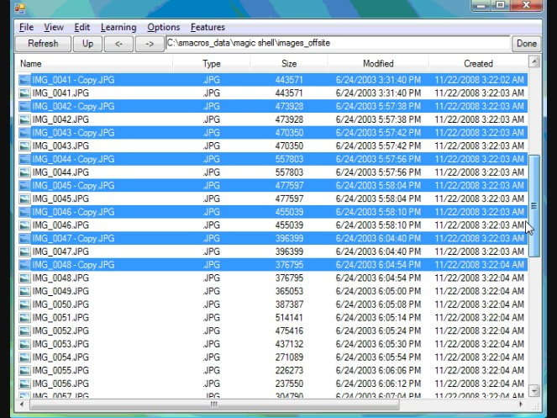
Training the Label Regressor
Labels
User Applies some operation on files
Step 1
Step 2
Step 2
Step n
Step 1
Step 2
Step 3
…
Step n
Extract Features
Extract Features
Extract Features

Slide 19
Lots of labeled data!
m files, n steps, j tasks, k users
Produces labeled examples
Plenty of data available for LR!
No need to manually label
Personalization

Slide 20

Training Selection Classifier
Explicit Labels
Implicit Labels
Label Regressor produces a label and a weight/confidence
Weight modulated by
Classify
Label
Selection Classifier
α
α
Label Regressor

Slide 21


Recap of Our Method
Label Regressor
Features based on User’s Behavior
Makes weighted predictions
Trained on historical data
Selection Classifier
Predicts which items to select
Trained on:
User’s explicit examples
Modulated predictions from Label Regressor
α

Slide 22
Outline
Smart Selection
Learning to Generalize
User Study
Conclusions

Slide 23
User Study
9 User pilot study
Gathered training data for LR
Full Study: 12 Participants
3 Conditions:
A: Standard shell (control)
B: Selection Classifier, but no Label Regressor
C: Selection Classifier + Label Regressor

Slide 24
Tasks
8 tasks for each condition
Isomorphic
Widely varying
Half were easy with sorting/block select
Widely varying directory sizes

Slide 25
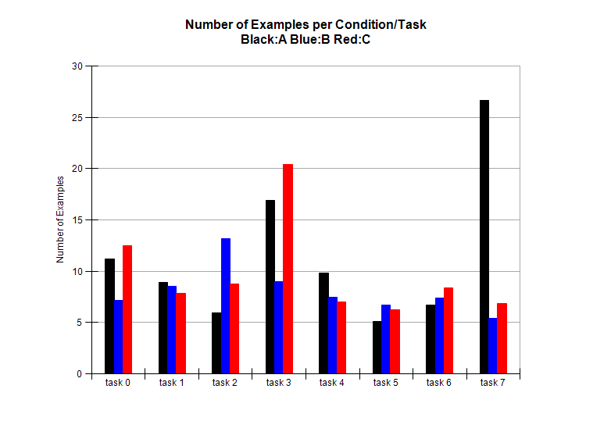
Number of Examples
manual selection
smart selection, explicit labels only
smart selection, explicit + soft labels
# examples
task
Notes:
PlotStuff.PlotPR("pilotTrain")

Slide 26
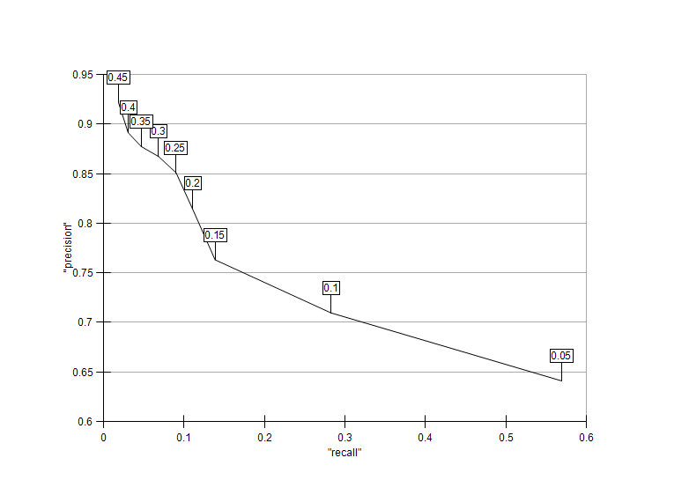
How accurate are LR posteriors?
Notes:
PlotStuff.PlotPR("pilotTrain")

Slide 27
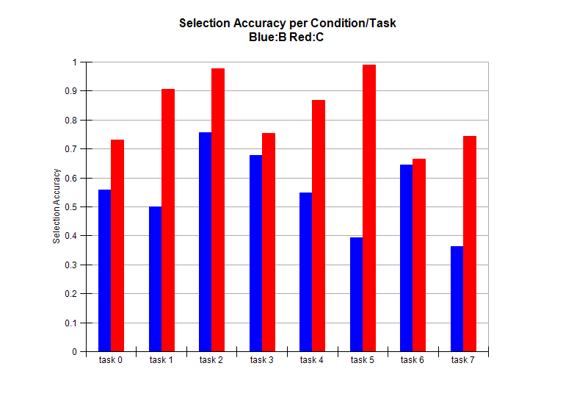
Selection Accuracy
smart selection, explicit labels only
smart selection, explicit + soft labels
accuracy
task
Notes:
PlotStuff.PlotPR("pilotTrain")

Slide 28
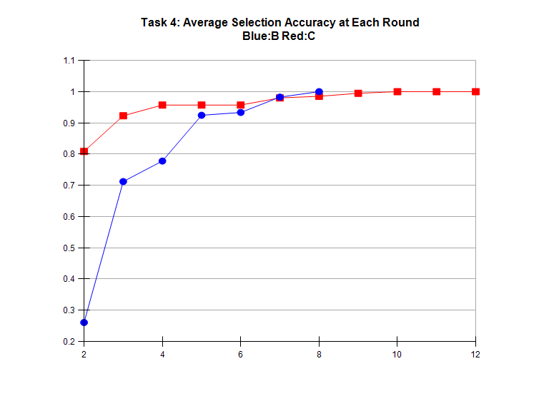
Closer to goal in early rounds
smart selection, explicit labels only
smart selection, explicit + soft labels
accuracy
Advantages:
Less Dramatic changes
Switch to manual & quickly complete
step

Slide 29
Conclusions
Take advantage of data from other tasks!
Lots of data
Cheap
Behavior features can reliably predict selection
Thank You!

Slide 30
Quotes:
“The 2nd method (B) seemed a more "aggressive" version of method 1 (C). However the UI presentation i.e. the selection and deselection of large numbers of files strained my eyes and annoyed me.”
“Selecting more files than desired can seem dangerous in some situations - especially when selecting files to delete or modify.”

